Slide 1
CSS
Designing the world !

Slide 2
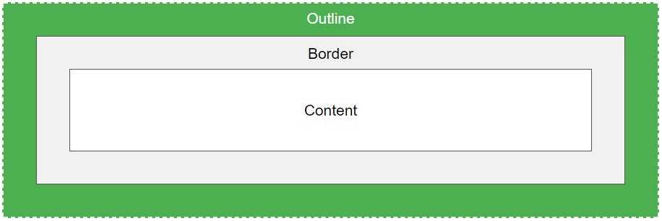
outline
An outline is a line that is drawn around elements, OUTSIDE the borders, to make the element "stand out".
The outline of the element overlaps the neighboring elements

Slide 3
outline(1)
CSS has the following outline properties:
outline-style : dotted dashed solid double ..
outline-color
outline-width
outline

Slide 4
outline(2)
outline-offset : adds space between an outline and the edge/border of an element. The space between an element and its outline is transparent.
Ex.
p { margin: 30px; background: yellow; border: 1px solid black; outline: 1px solid red; outline-offset: 15px; }

Slide 5
links
links can be styled differently depending on what state they are in. links are texts
The four links states are:
a:link - a normal, unvisited link
a:visited - a link the user has visited
a:hover - a link when the user mouses over it
a:active - a link the moment it is clicked

Slide 6
Lists style
list-style-image (specifies an image as the list item marker)
We can also style lists with colors, to make them look a little more interesting.

Slide 7
List style(1)
ol { background: #ff9999; padding: 20px; } ul { background: #3399ff; padding: 20px; } ol li { background: #ffe5e5; padding: 5px; margin-left: 35px; } ul li { background: #cce5ff; margin: 5px; }

Slide 8
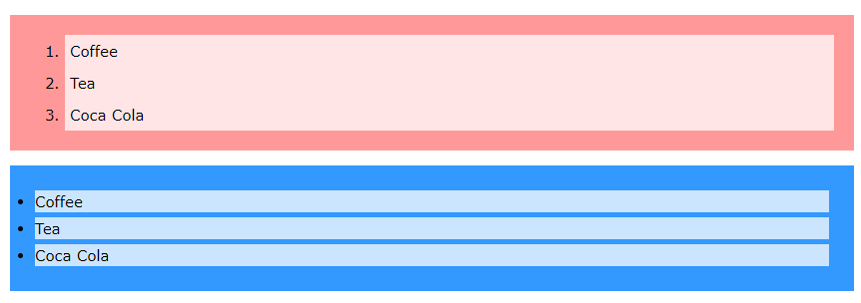

Slide 9
Table style

Slide 10
icons
The simplest way to add an icon to your HTML page, is with an icon library, such as Font Awesome.
To use the Font Awesome icons, add the following line inside the <head> section of your HTML page:
<link rel="stylesheet" href="https://cdnjs.cloudflare.com/ajax/libs/font-awesome/4.7.0/css/font-awesome.min.css">

Slide 11
How to use font awesome (fa)
The easiest way is a span element
<span class=“fa fa-{{icon}} {{propeities}}”></span>
Search for icons
https://fontawesome.com/icons?d=gallery

Slide 12
Fa : list icons
class="fa-li fa fa-check-square "
class="fa-li fa fa-spinner fa-spin "
class="fa-li fa fa-square"

Slide 13
Fa : Animated Icons
The fa-spin class gets any icon to rotate, and the fa-pulse class gets any icon to rotate with 8 steps.

Slide 14
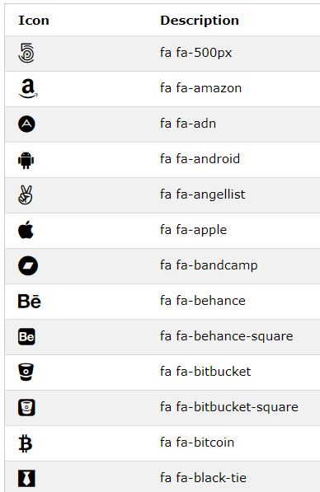
Fa : brands
More in
https://www.w3schools.com/icons/fontawesome_icons_brand.asp

Slide 15
More about font awesome
https://www.w3schools.com/icons/fontawesome_icons_intro.asp

